Slide 1
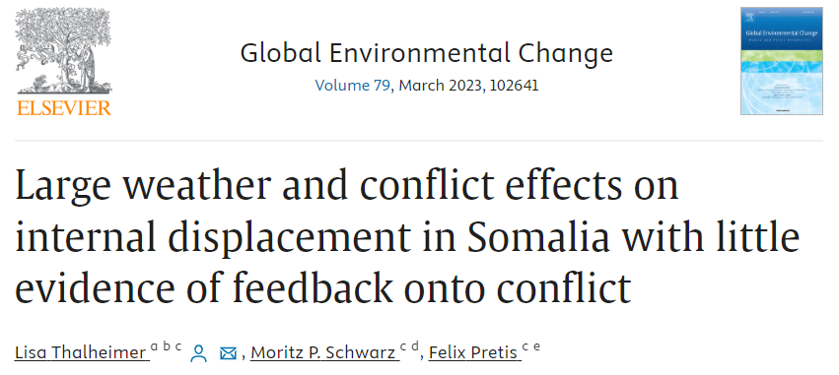

Slide 2
The paper explores the individual contributions of extreme weather and conflict to forced displacement.-
Using disaggregated data on internal displacement in Somalia from 2016 to 2018, the study examines the effects of weather and conflict on displacement and vice versa.-
Findings suggest significant non-linear effects of weather on displacement, with temperature anomalies leading to a substantial increase in displaced individuals and reduced precipitation also causing a significant rise in displacement.-
Conflict events also significantly impact displacement, but this effect is masked when data is aggregated.-
Interestingly, displacement itself doesn't seem to have a noticeable effect on the occurrence of conflict events.

Slide 3
Introduction
Extreme weather, potentially influenced by climate change, and conflict are major drivers of internal displacement.-
Understanding the causal drivers of displacement is crucial for optimal allocation of aid and resources.-
African drylands are particularly vulnerable to extreme weather events, which can lead to various challenges, including impacts on agriculture, food and water security, employment, and conflict.-
In 2021, over 23 million new displacements were attributed to weather and climate-related events, with a significant portion occurring in African drylands.-
The paper aims to quantify the interaction between extreme weather, conflict, and displacement using data from all of Somalia's 18 regions between 2016 and 2018.

Slide 4
Data
The study uses data from the Protection and Return Monitoring Network (PRMN) survey on internal displacement in Somalia, collected by the United Nations High Commissioner for Refugees (UNHCR).
Extreme weather is measured using temperature and precipitation anomalies, sourced from the Berkeley Earth dataset for temperature and the Climate Hazards Groups Infrared Precipitation with Stations dataset (CHIRPS) for precipitation
Conflict data is sourced from the Armed Conflict Location and Event Data Project (ACLED) database, which records violent conflict events.

Slide 5
The effects of extreme weather on displacement
The study first investigated the effect of weather shocks on total displacement, considering all reported reasons for displacement.-
Significant non-linear effects of temperatures on displacement were observed. Specifically, an increase in temperatures from 1°C to 2°C is associated with a tenfold increase in predicted internally displaced persons (IDPs). However, the response appears to be non-linear, with a change from 0°C to 1°C only leading to close to a doubling in predicted IDPs.-
A reduction from 50 mm of monthly precipitation to 0 mm leads to a fourfold increase in predicted IDPs.-
The effects of weather on displacement are in agreement with other studies, such as Pape and Wollburg (2019), who found that the 2016/17 drought increased poverty and hunger in rural areas across Somalia. These effects are even more pronounced when considering repeated drought shocks.

Slide 6
The effects of conflict on displacement
The study presents the effects of conflict events on overall displacement as well as for the subset of IDPs who self-reported being displaced due to conflict.-
When modeling the aggregate displacement response (summed over all self-reported categories including conflict and drought) as a function of conflict at the origin region, the study found no statistically significant effects of conflict on displacement. However, this result is likely influenced by data aggregation and the merging of different reasons for displacement.-
The number of IDPs reporting to be displaced due to droughts seems to overshadow the conflict signal. This increased noise in the data results in low statistical power to detect the effects of conflict on displacement.-
When focusing on the subset of IDPs who self-report being displaced due to conflict, the study found large and significant effects. Specifically: - An increase of 25 conflict events (approximately a 1.5 standard deviation increase in conflict events) compared to no conflict events in a month leads to a predicted 50-fold increase in the number of IDPs. -
This increase doubles again when considering a rise from 25 to 50 conflict events. -
These results remain robust even when controlling for weather shocks.-
The study also highlights that testing for an effect of conflict on total displacement can mask the conflict signal. This suggests that data aggregation can lead to a misleading conclusion that conflict has no effect on displacement.-
As a robustness check, the study also looked at the intensity of conflict using the number of conflict-induced fatalities.
The results showed large and significant effects of conflict intensity (proxied by fatalities) on displacement.
In summary, while aggregated data might not immediately show the effects of conflict on displacement, when the data is broken down and analyzed more granularly, conflict emerges as a significant driver of internal displacement. The intensity and frequency of conflict events have a pronounced impact on the number of IDPs, especially when considering those who attribute their displacement directly to conflict.

Slide 7
Displacement effects on conflict
delves into the investigation of whether internally displaced persons (IDPs) arriving in a new region contribute to the conflict in that destination. The underlying hypothesis is that arriving displacement might increase pressures on scarce resources such as food and drinking water, potentially leading to conflict. Here are the key details from this section:
1. *Concerns Addressed*: The analysis addresses two main concerns: -
*Conflict Spillover Effects*: There might be instances where neighboring regions experience conflict simultaneously, which could be mistakenly attributed to IDPs moving into a region.
*Reverse Causality*: IDPs might choose to move to regions with low conflict, leading to potential biases in the analysis.
2. *Findings*:
- Despite potential biases that might overestimate the effect of displacement on conflict, the study finds *no statistically significant effect* of incoming IDPs on conflict (as depicted in Fig. 6). -
As an additional robustness check, the study re-estimates the model using only in-migration driven by droughts. The rationale is that studying the effects of IDPs displaced due to weather on conflict could more closely isolate the displacement effect, reducing potential spillovers through conflict channels. -
The study finds no statistically significant effect of displacement on conflict at the destination, even when considering temporally lagged models that account for past displacement affecting present conflict. This holds true for models both with and without controlling for weather effects.
3. *Implications*:
- The findings suggest that arriving IDPs do not appear to increase the probability of conflict in their destination region. This challenges concerns around migration-induced conflict, potentially arising from migration-induced resource scarcity.
- The results indicate that concerns about displacement leading to increased conflict, perhaps through pressures on resources, might be unfounded.
In summary, the paper finds little evidence to suggest that internal displacement, whether due to extreme weather or other reasons, contributes to an increase in conflict in the regions where the displaced individuals arrive. This is an important insight, as it challenges some common perceptions about the potential negative impacts of internal displacement on regional stability.

Slide 8
Findings
Extreme weather in the form of droughts and high temperatures significantly increases internal displacement.-
Increases in armed conflict also lead to substantial internal displacement.-
When considering only displacement data aggregated over weather and conflict-driven reasons, the effects of conflict on displacement become less apparent.-
Contrary to some previous studies, there's little evidence to suggest that displacement itself affects the number of occurring conflict events.

Slide 9
The paper titled "Large weather and conflict effects on internal displacement in Somalia with little evidence of feedback onto conflict" by Lisa Thalheimer, Moritz P. Schwarz, and Felix Pretis, published in Global Environmental Change, delves into the relationship between extreme weather, conflict, and internal displacement in Somalia. Here's a detailed summary of the findings:
1. *Background & Objective*: - The paper aims to understand the individual contributions of extreme weather and conflict to forced displacement in Somalia. - The research uses disaggregated data on internal displacement in all of Somalia's subregions from 2016 to 2018, combined with weather and conflict data.
2. *Key Findings*: - There are significant non-linear effects of weather on displacement. An increase in temperature anomalies from 1°C to 2°C leads to a tenfold increase in displaced people. - A reduction in precipitation from 50 mm to 0 mm results in approximately a fourfold increase in displacement. - Conflict events have a significant impact on displacement. A 1.5 standard deviation increase in conflict events leads to a 50-fold increase in displacement. - Interestingly, displacement itself doesn't seem to have a detectable effect on the occurrence of conflict events.
3. *Introduction*: - Extreme weather, potentially exacerbated by climate change, and conflict are major drivers of population displacement within countries. - African drylands are projected to be severely affected by more intense and frequent extreme weather events, leading to challenges like reduced agricultural production, food and water insecurity, and conflict. - In 2021, over 23 million new displacements occurred due to weather and climate-related events, with a significant portion in African drylands.
4. *Data & Methods*: - The research uses data from the Protection and Return Monitoring Network (PRMN) survey on internal displacement in Somalia, collected by the United Nations High Commissioner for Refugees (UNHCR). - Extreme weather is measured using the Berkeley Earth dataset for temperature and the Climate Hazards Groups Infrared Precipitation with Stations dataset (CHIRPS) for precipitation. - Conflict data is sourced from the Armed Conflict Location and Event Data Project (ACLED) database.
5. *Discussion*: - The paper contributes to the understanding of human mobility in response to climate change and the interaction of multi-causal drivers of human mobility, such as environmental and political factors. - The findings are crucial for designing climate and security policy measures that can strengthen resilience to weather and conflict shocks, especially among displaced populations.
6. *Conclusion*: - The research provides empirical evidence on the interaction pathways of extreme weather, conflict, and displacement. It emphasizes the need for evidence-based design of preventive security policies and climate policies at the local level to support effective anticipatory humanitarian action. The paper provides a comprehensive analysis of the factors leading to internal displacement in Somalia and offers valuable insights for policymakers and humanitarian organizations.

